Slide 1

https://github.com/zinkki
JEONG YUJIN
PORTFOLIO

Slide 2

Contents
01
02
03
04
My Github
My Project
Demonstrate a project
Q&A

Slide 3
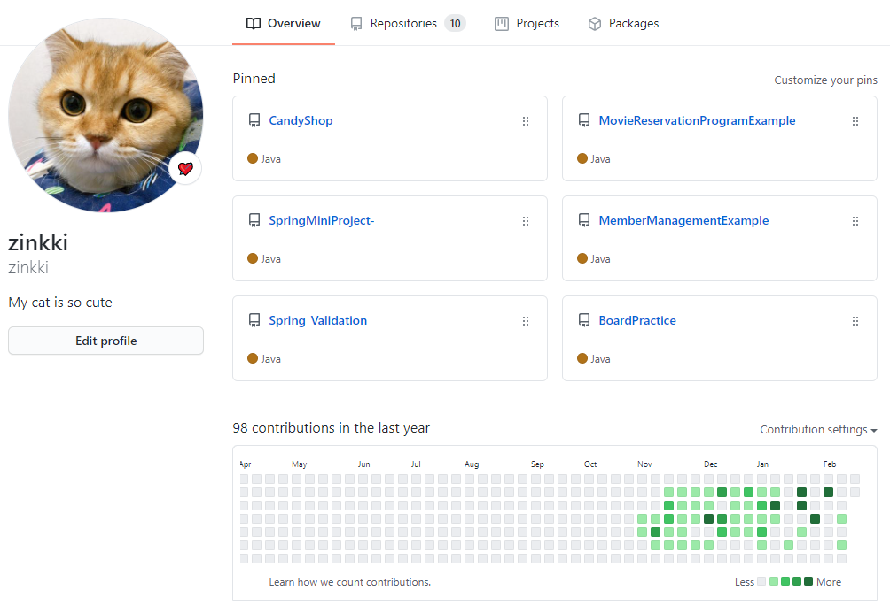
My GitHub
https://github.com/zinkki

Slide 4
My Project
https://github.com/zinkki/CandyShop

Slide 5












Environment
Development Environment
Linux
AWS EC2
AWS RDS
Apache Tomcat9.0
eclipse
Java JDK8
Jsp Servlet
JavaScript
HTML
CSS
ORACLE 11g
SQL Developer

Slide 6
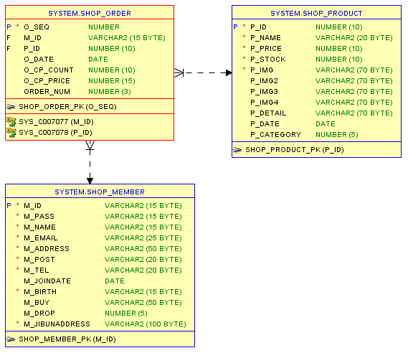
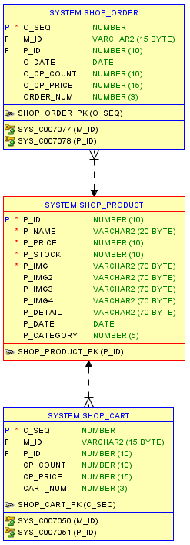
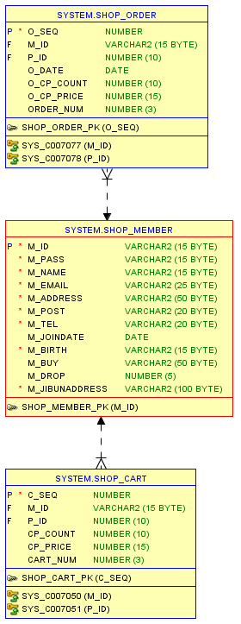
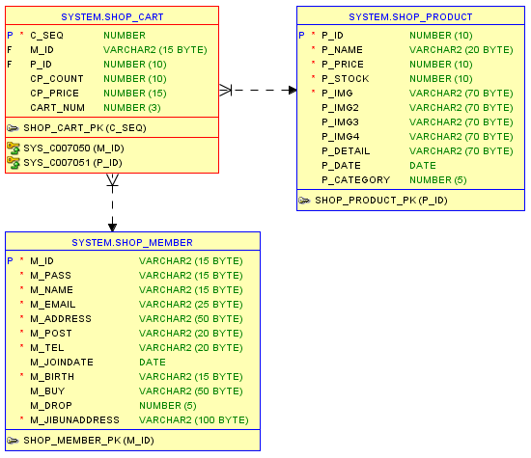
Database
DB Table

Slide 7
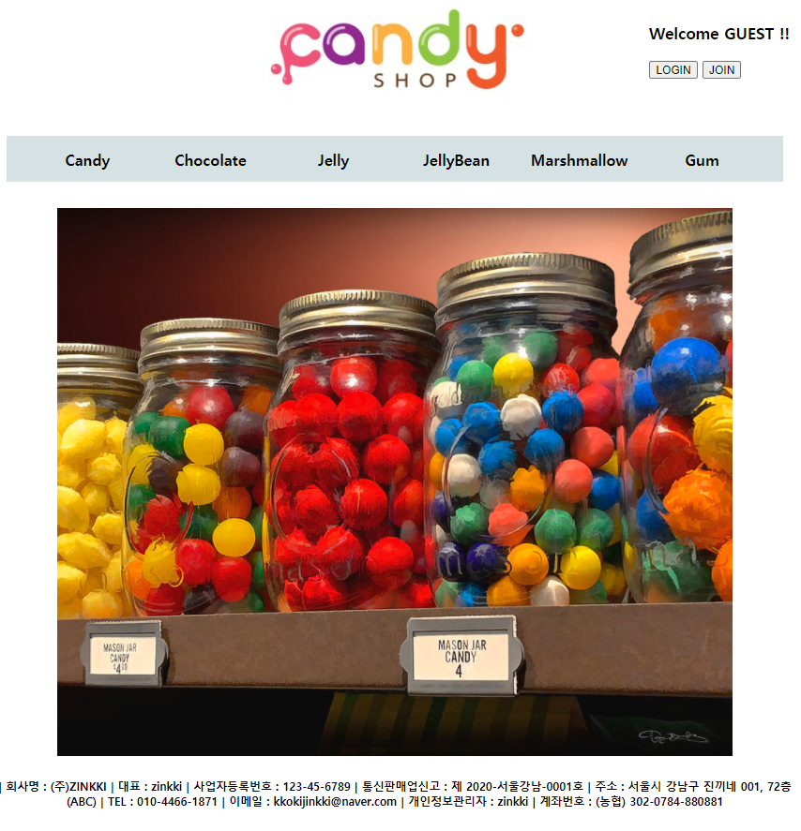
Demonstrate
Main Page
Main
Admin Page
Join & Login
Product Info
Cart
Cancel
Order
My Page

Slide 8
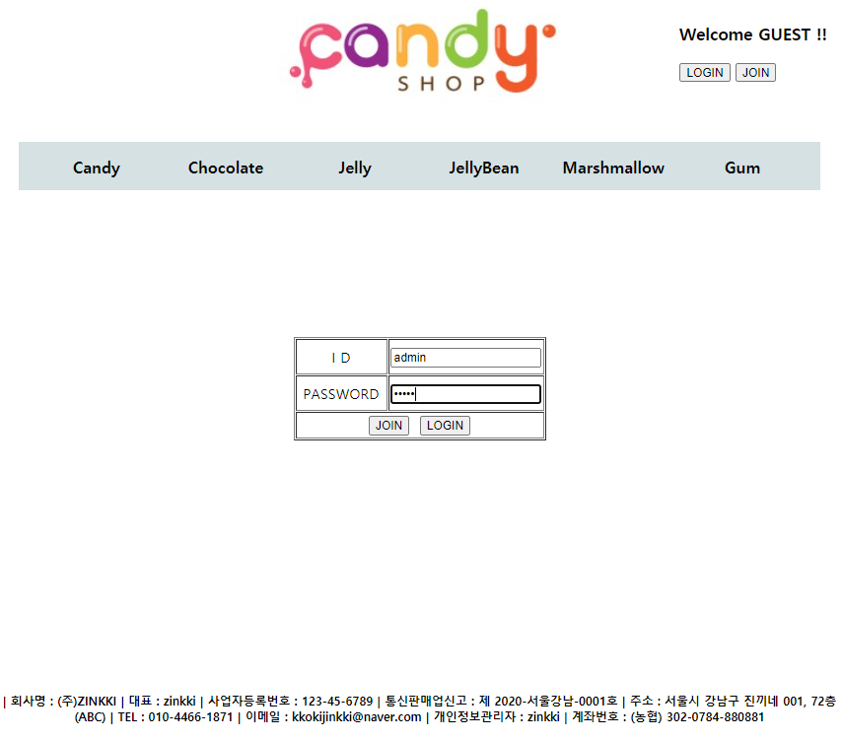
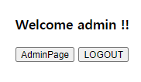
Demonstrate
Admin Login
Main
Admin Page
Join & Login
Product Info
Cart
Cancel
Order
My Page
ID | admin
PW | admin

Slide 9
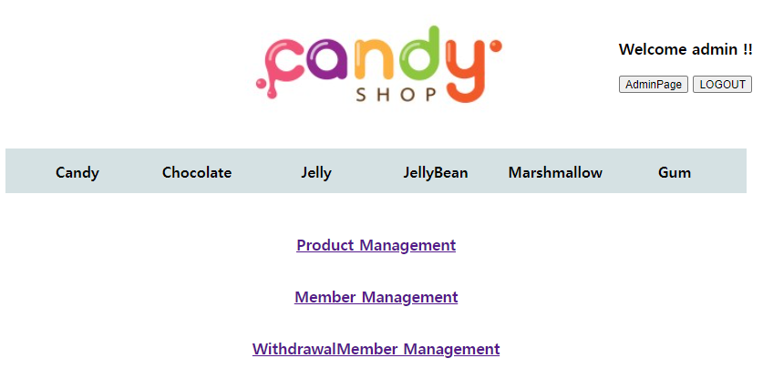
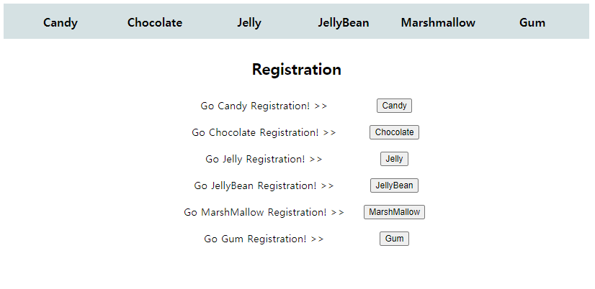
Demonstrate
Admin Page
Main
Admin Page
Join & Login
Product Info
Cart
Cancel
Order
My Page

Slide 10
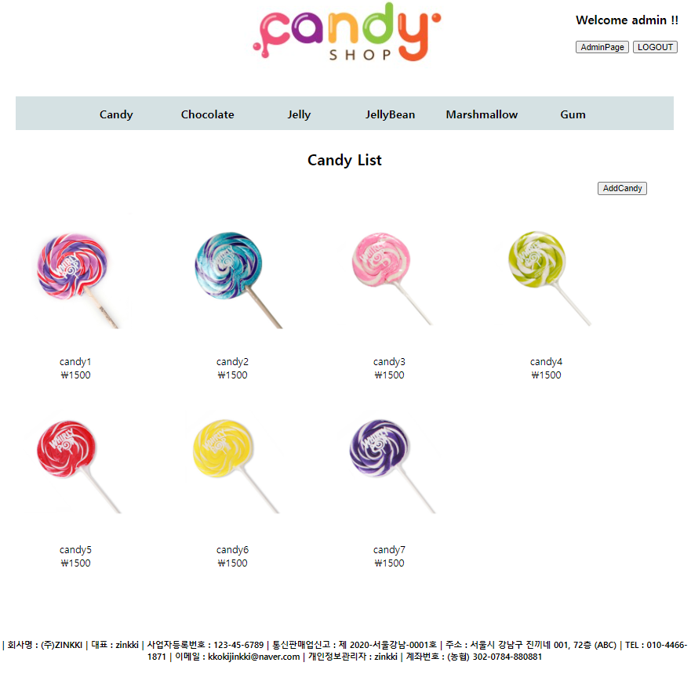
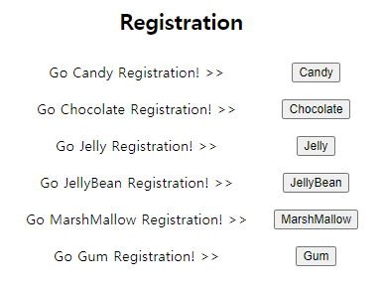
Demonstrate
Registration
Main
Admin Page
Join & Login
Product Info
Cart
Cancel
Order
My Page

Slide 11
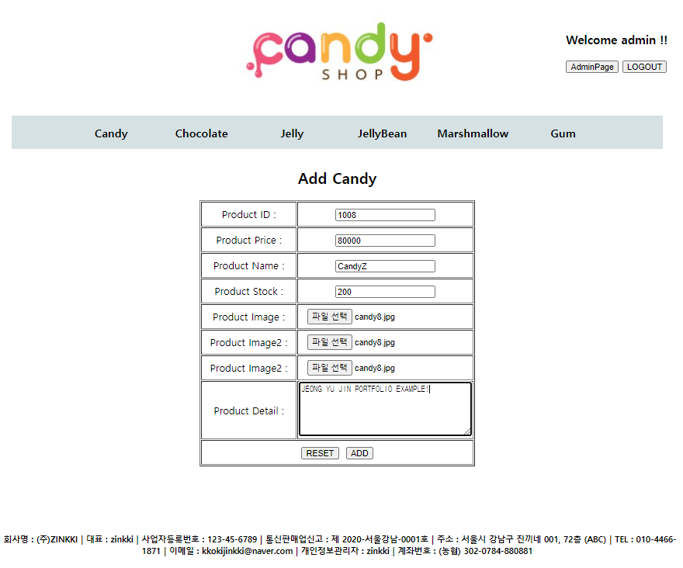
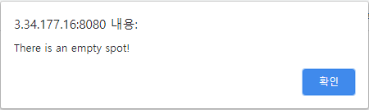
Demonstrate
Registration
Main
Admin Page
Join & Login
Product Info
Cart
Cancel
Order
My Page
When there’s blank

Slide 12
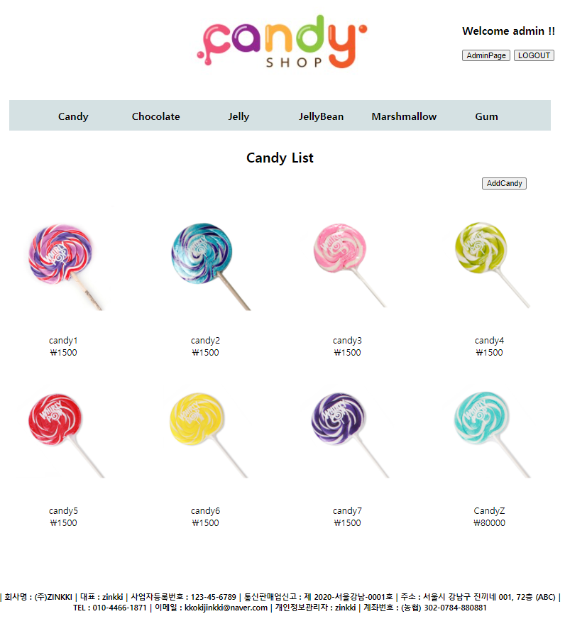
Demonstrate
Registration
Main
Admin Page
Join & Login
Product Info
Cart
Cancel
Order
My Page

Slide 13
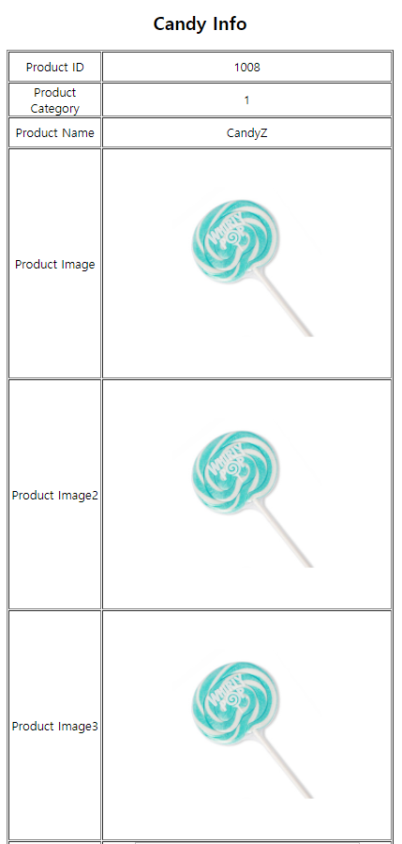
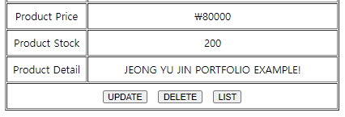
Demonstrate
Registration
Main
Admin Page
Join & Login
Product Info
Cart
Cancel
Order
My Page

Slide 14
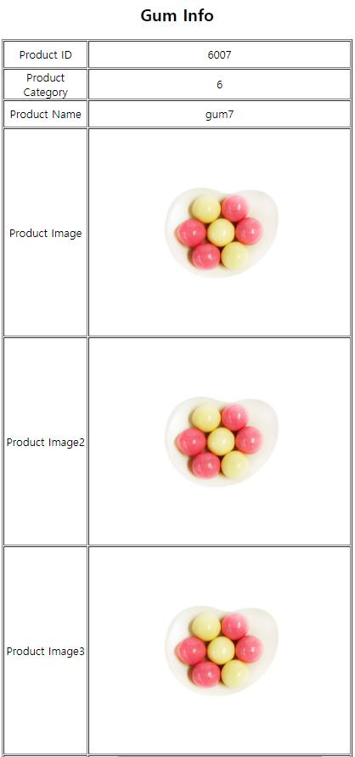
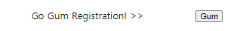
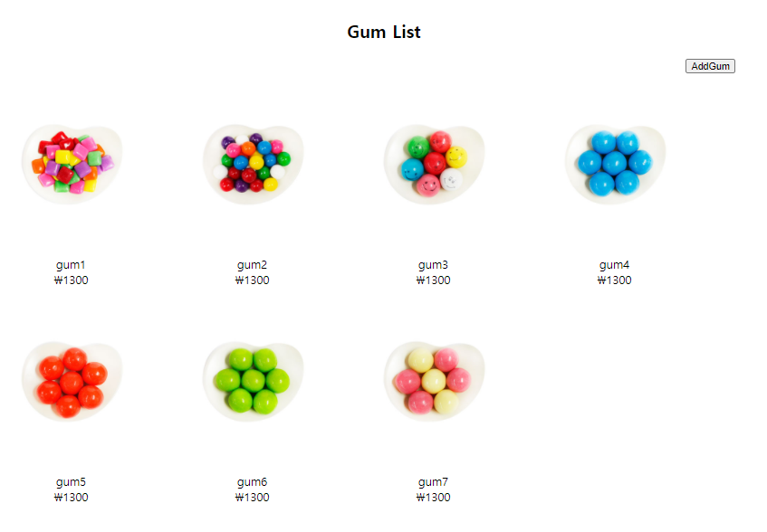
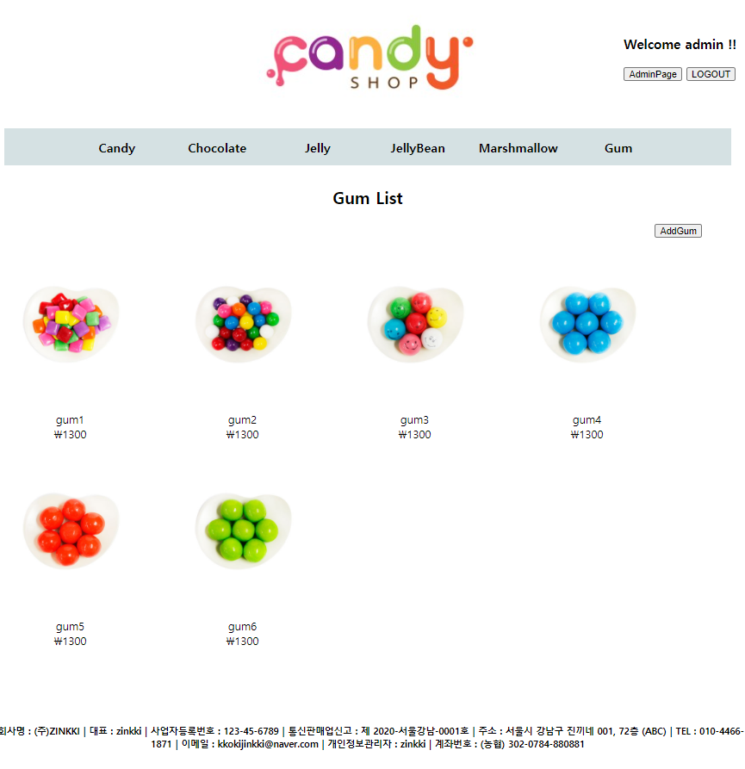
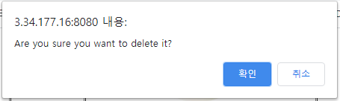
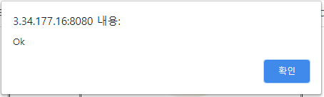
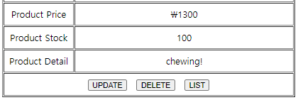
Demonstrate
Delete
Main
Admin Page
Join & Login
Product Info
Cart
Cancel
Order
My Page

Slide 15
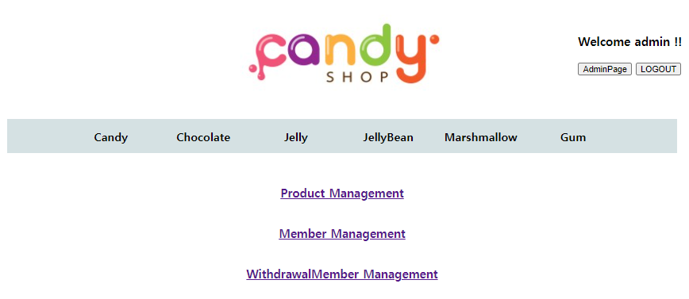
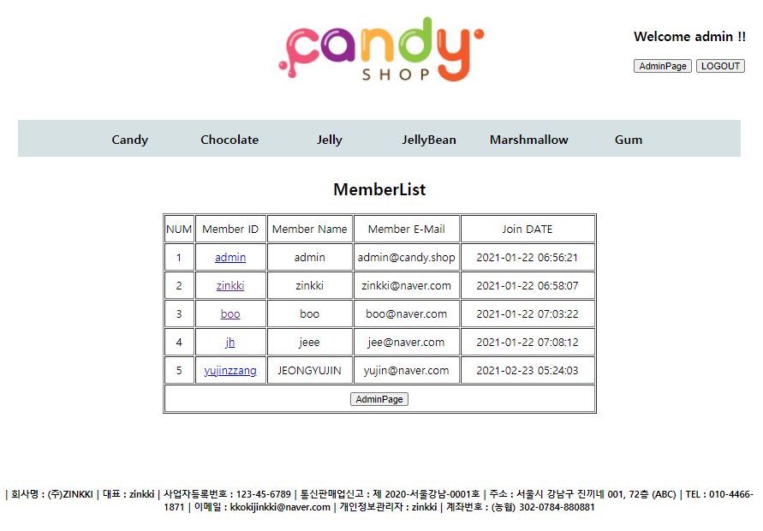
Demonstrate
Member Management
Main
Admin Page
Join & Login
Product Info
Cart
Cancel
Order
My Page

Slide 16
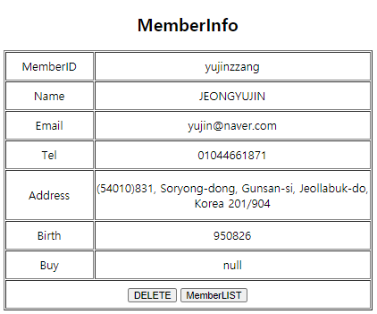
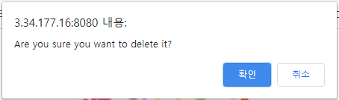
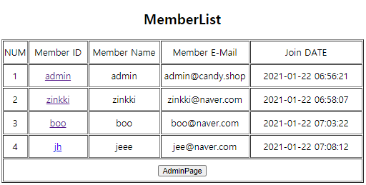
Demonstrate
Delete Member
Main
Admin Page
Join & Login
Product Info
Cart
Cancel
Order
My Page

Slide 17
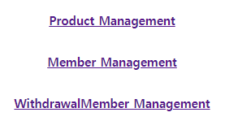
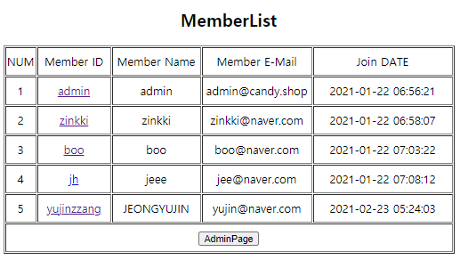
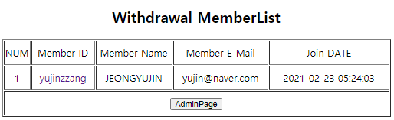
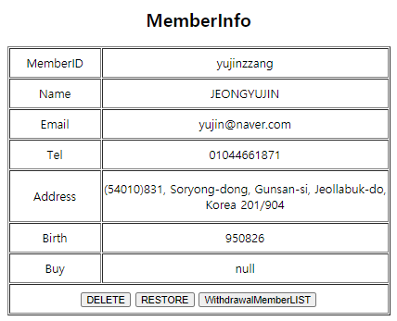
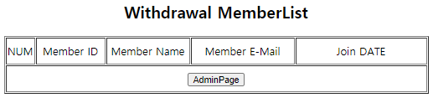
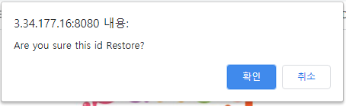
Demonstrate
Deleted Member Restore
Main
Admin Page
Join & Login
Product Info
Cart
Cancel
Order
My Page

Slide 18
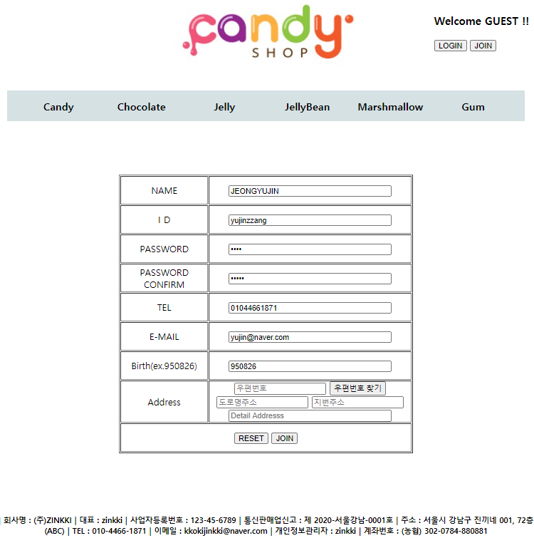
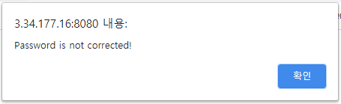
Demonstrate
Join Page
Main
Admin Page
Join & Login
Product Info
Cart
Cancel
Order
My Page
When there’s blank
When password is different

Slide 19
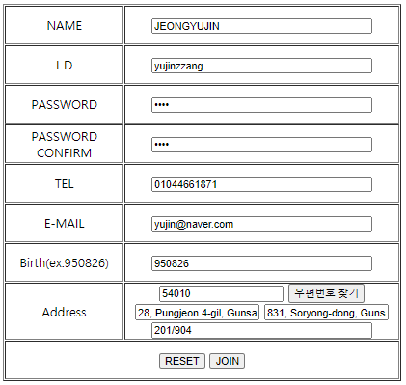
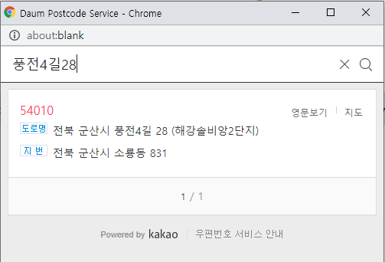
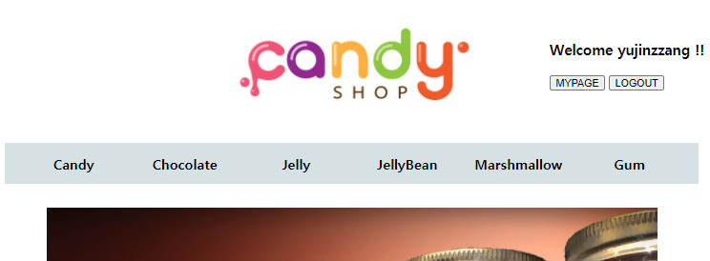
Demonstrate
Join Address & Success
Main
Admin Page
Join & Login
Product Info
Cart
Cancel
Order
My Page

Slide 20
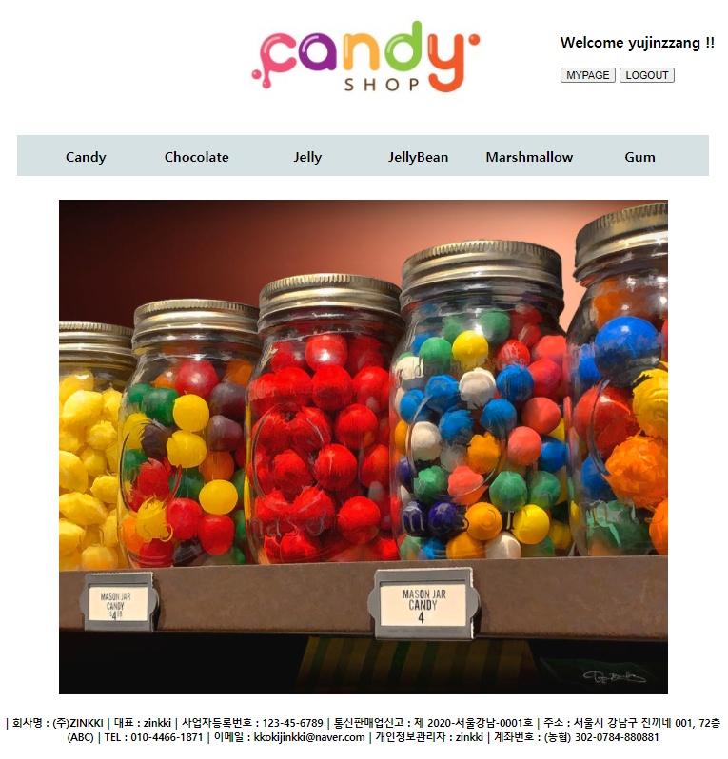
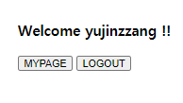
Demonstrate
Join Success
Main
Admin Page
Join & Login
Product Info
Cart
Cancel
Order
My Page

Slide 21
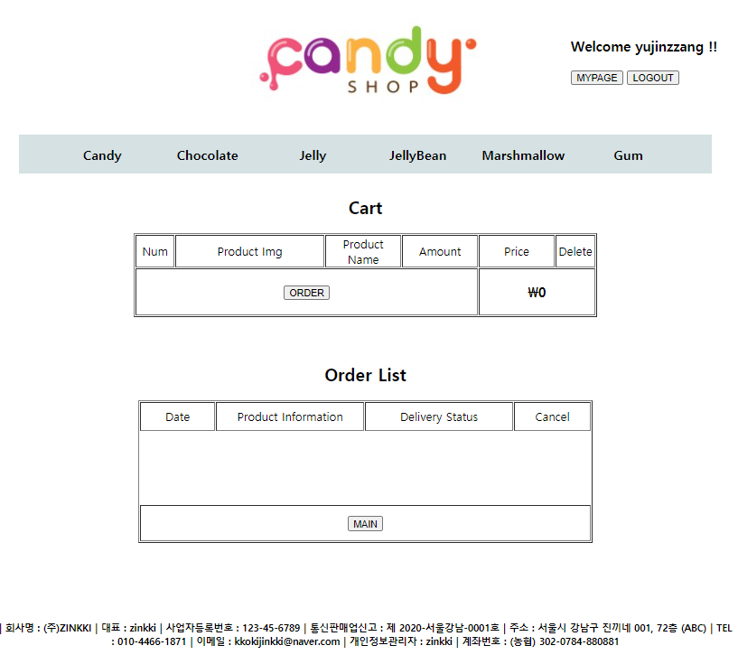
Demonstrate
My Page
Main
Admin Page
Join & Login
Product Info
Cart
Cancel
Order
My Page

Slide 22
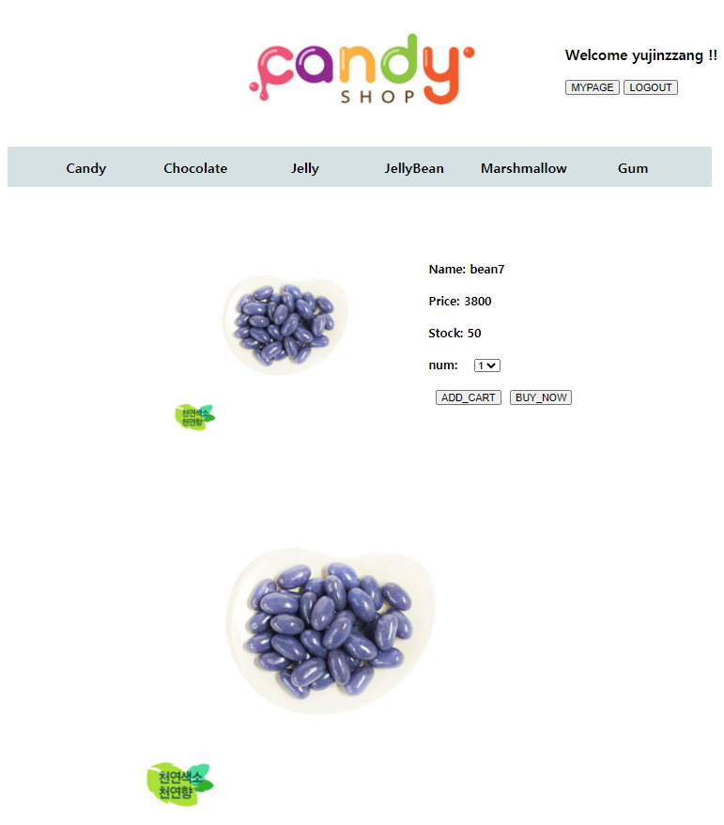
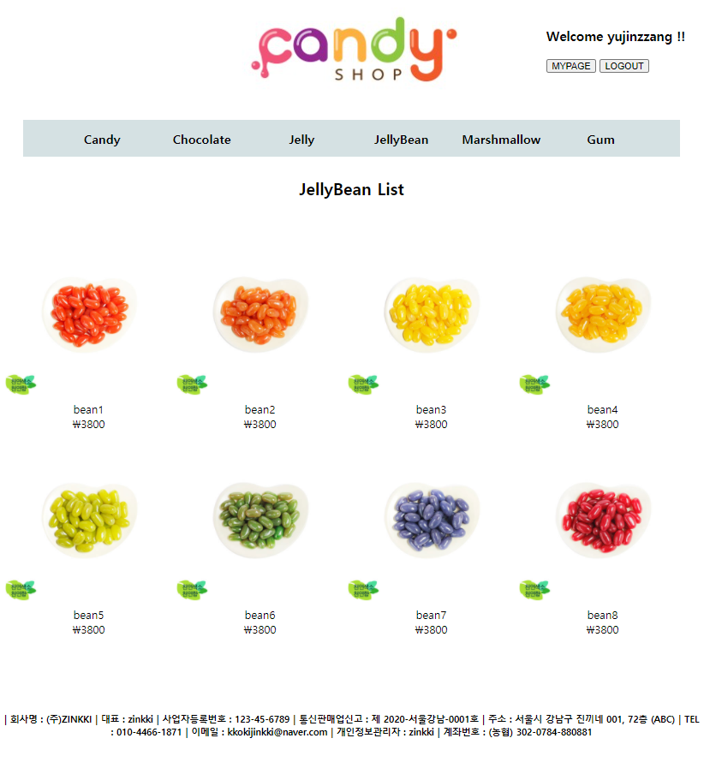
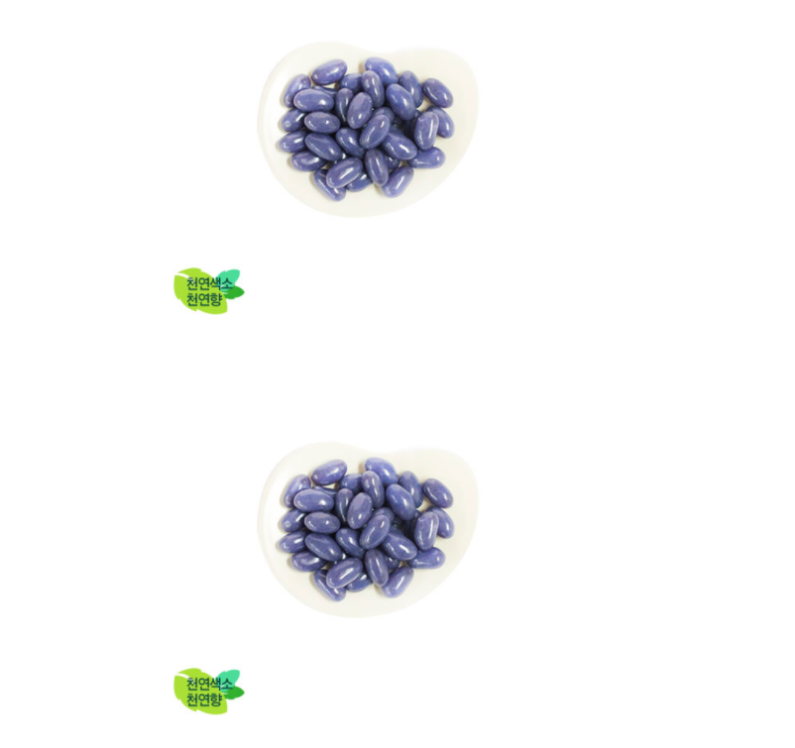
Demonstrate
Product Info
Main
Admin Page
Join & Login
Product Info
Cart
Cancel
Order
My Page

Slide 23
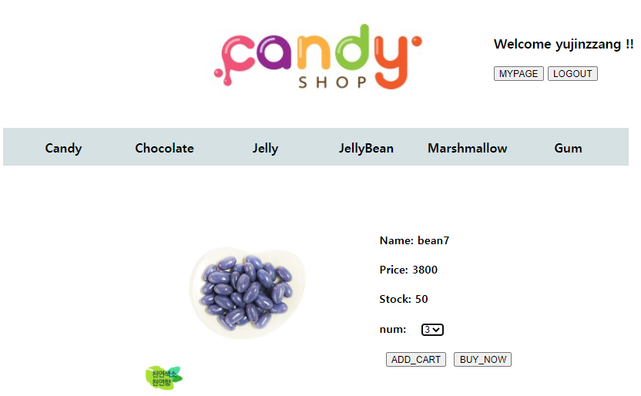
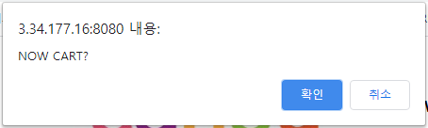
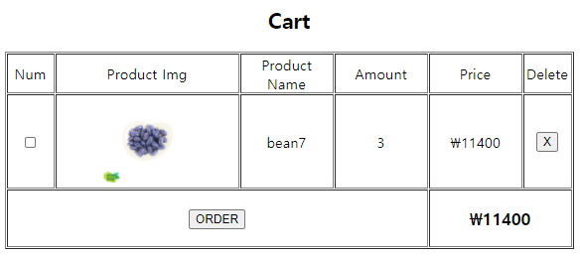
Demonstrate
Add Cart
Main
Admin Page
Join & Login
Product Info
Cart
Cancel
Order
My Page

Slide 24
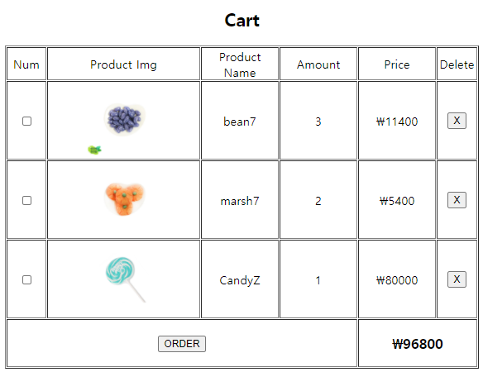



Demonstrate
Delete Cart
Main
Admin Page
Join & Login
Product Info
Cart
Cancel
Order
My Page

Slide 25




Demonstrate
Order
Main
Admin Page
Join & Login
Product Info
Cart
Cancel
Order
My Page

Slide 26


Demonstrate
Payment
Main
Admin Page
Join & Login
Product Info
Cart
Cancel
Order
My Page

Slide 27



Demonstrate
Order Success
Main
Admin Page
Join & Login
Product Info
Cart
Cancel
Order
My Page

Slide 28


Demonstrate
My Page
Main
Admin Page
Join & Login
Product Info
Cart
Cancel
Order
My Page

Slide 29
My Project
https://github.com/zinkki/SpringMiniProject-

Slide 30



Environment
Development Environment
Windows 10
eclipse
Java JDK8
Apache Tomcat9.0
Spring Framework
JSP Servlet
JavaScript
GitHub
HTML
CSS
ORACLE 11g
SQL Developer

Slide 31

Database
DB Table

Slide 32

Demonstrate
Main Page
Main
Join
Login
Write
Read
Modify
Delete
Logout

Slide 33

Demonstrate
Join Page
Main
Join
Login
Write
Read
Modify
Delete
Logout

Slide 34




Demonstrate
Join Page & Validation
Main
Join
Login
Write
Read
Modify
Delete
Logout

Slide 35




Demonstrate
Login Fail & Login Success
Main
Join
Login
Write
Read
Modify
Delete
Logout

Slide 36



Demonstrate
Write & Write Validation
Main
Join
Login
Write
Read
Modify
Delete
Logout

Slide 37



Demonstrate
Write
Main
Join
Login
Write
Read
Modify
Delete
Logout

Slide 38


Demonstrate
Read My Writing
Main
Join
Login
Write
Read
Modify
Delete
Logout

Slide 39


Demonstrate
Read
Main
Join
Login
Write
Read
Modify
Delete
Logout

Slide 40




Demonstrate
Modify
Main
Join
Login
Write
Read
Modify
Delete
Logout

Slide 41


Demonstrate
Delete
Main
Join
Login
Write
Read
Modify
Delete
Logout

Slide 42




Demonstrate
Logout
Main
Join
Login
Write
Read
Modify
Delete
Logout

Slide 43

My GitHub
https://github.com/zinkki/LoopyBookProject

Slide 44
Environment
Development Environment
Windows 10
eclipse
Java JDK8
Apache Tomcat9.0
Spring Framework
JSP Servlet
JavaScript
GitHub
HTML
CSS
ORACLE 11g
SQL Developer

Slide 45



Database
DB Table

Slide 46

Demonstrate
Main Page
Main
Join & Login
Book List
Book Info

Slide 47


Demonstrate
Login Page
Main
Join & Login
Book List
Book Info
Login failed
Login success >> main page

Slide 48

Demonstrate
Join Page
Main
Join & Login
Book List
Book Info

Slide 49


Demonstrate
Join Page
Main
Join & Login
Book List
Book Info

Slide 50


Demonstrate
Join Page
Main
Join & Login
Book List
Book Info

Slide 51


Demonstrate
Join Page
Main
Join & Login
Book List
Book Info
Join success >> main page

Slide 52

Demonstrate
Book List
Main
Join & Login
Book List
Book Info

Slide 53

Demonstrate
Book List
Main
Join & Login
Book List
Book Info

Slide 54

Demonstrate
Book Info
Main
Join & Login
Book List
Book Info

Slide 55

Demonstrate
Book Info
Main
Join & Login
Book List
Book Info

Slide 56
Demonstrate
LoopyBookProject 는 지금까지 진행 중입니다.

Slide 57
Thank you!

